Slide 1

CS 290 - MVC + Angular JS

Slide 2

Componentizing a page

Slide 3
MVC
Model-View-Controller (MVC) is one of the most mentioned patterns in the web programming world.
  Also very important in regular non-web application development.
  Makes for a good interview question, so listen up!
Notes:
First

Slide 4
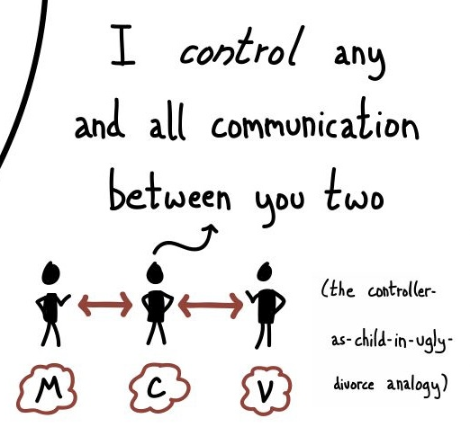
First - a funny analogy
Like most analogies, if you take it too far - it will break down. So don't! Just use it to form a basis.

Slide 5
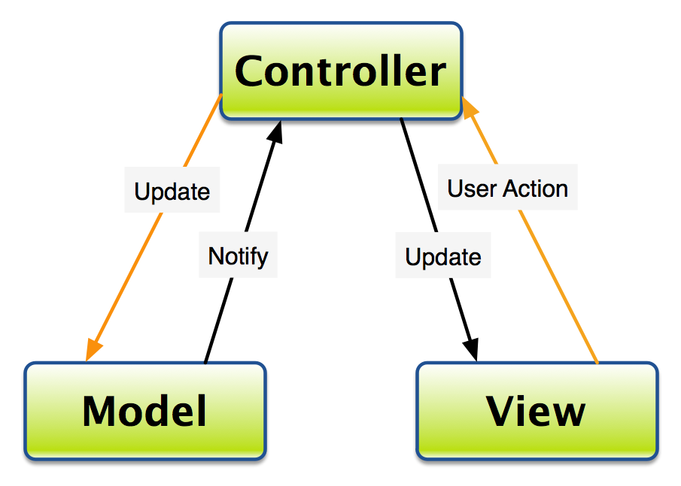
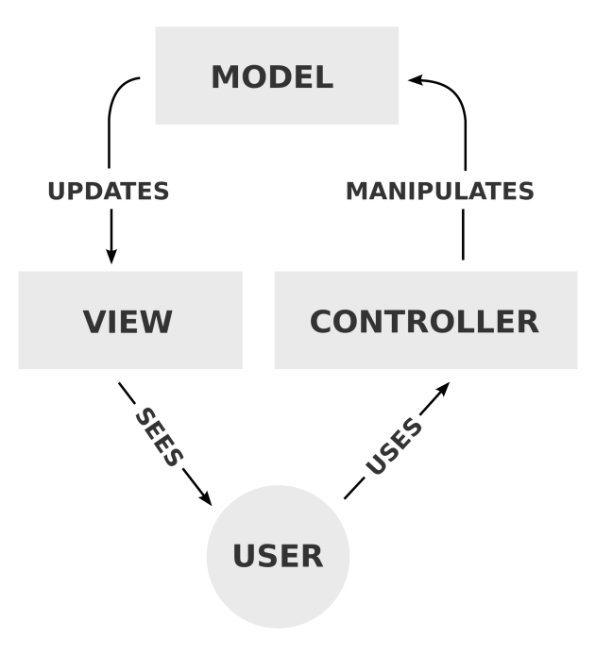
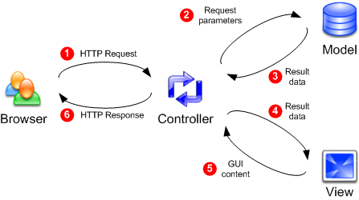
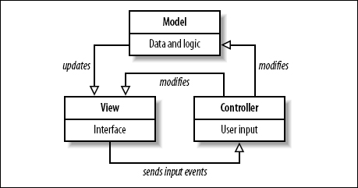
The concept

Slide 6
So what is MVC?
MVC is a framework describing one way to break down your code, functions/responsibilites, to increase its efficiency, maintainability and modularity (among other things).
Lets look at one page next

Slide 7
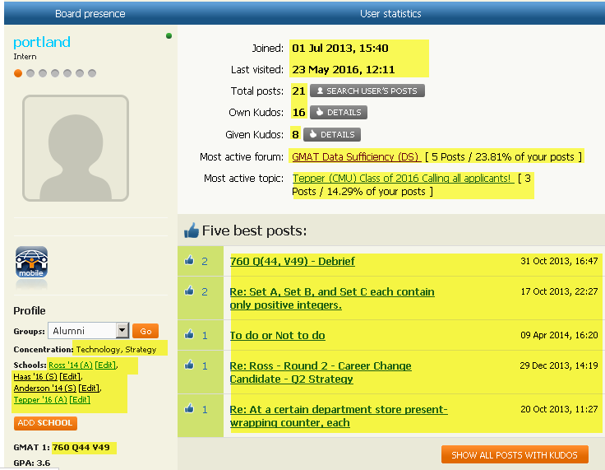
A typical dynamic data-driven page
A section of the user profile view on gmatclub.com, the highlighted info is all user specific and populated at runtime

Slide 8
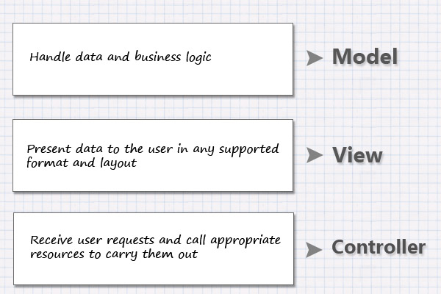
MVC

Slide 9
Some links to read:
  On wikipedia
  MVC from a web programming perspective
Using our Exchange Fund Assignment as an example, how would you break down the three different parts?

Slide 10
Questions?

Slide 11
Anuglar JS
http://angularjs.org
A powerful javascript framework
  framework != library
Developed first at… where else - Google.
Can be included using a simple SDN
  <script src="https://ajax.googleapis.com/ajax/libs/angularjs/1.4.9/angular.min.js"></script>
Open source, cross-browser compliant
It was designed to develop rich, fluid, single page applications.

Slide 12
Typescript
A superset of Javascript.
  Javascript syntax is valid Typescript also, not the other way around
Javascript is dynamically typed(?). Typescript is statically typed.
Static typing has its advantages
  Fewer errors since variables/objects are explicitly defined. Especially helpful when multiple developers are working on the same codebase.
Typescript offers up some advanced features
  Classes, Lambda functions
  Typescript does OO similar to C++/Java

Slide 13
A note - Angular v1 and v2
V1: Simple startup, include a script file and get started
V2: Best used with TypeScript. The .ts code is then compiled into .js code to work with browsers
V2 is very much component based where as V1 is focused on modular codes divided by controllers.
V2 is in beta right now, many are actively using it.

Slide 14
Angular v1 and v2
Even syntax - structural directives - are different. ng-repeat is *ngFor
  Even naming convention changed from kebab-case to camelCase
V2 is faster and more mobile friendly
  The class based system allows for a better dependency injection system. This in turn means, code is only loaded when needed.

Slide 15
Said all that
We are going to wet our feet in Angular V1
Its simpler and easier to get started
My goal here is to show you how attractive programming with a framework like Angular can be AND to get you comfortable with tackling something that complex
So lets get started…
Notes:
Just setting up the environment for v2 would take away 30 minutes from the class.

Slide 16
Single Page Application
An SPA is a website that mostly fits onto a single page.
This creates a more cohesive user experience where all actions and reactions happen on a single canvas.
Its akin to using a desktop application.
With heavy use of Ajax and Javascript, one goal is that the page does not have to reload or transfer to another page

Slide 17
Examples
http://stevenmengin.com
http://www.reuters.tv/
Any that you can think of?

Slide 18
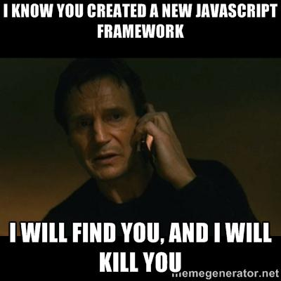
But… why???
There are a ton of frameworks out there.

Slide 19
A typical dynamic data-driven page
A section of the user profile view on gmatclub.com, the highlighted info is all user specific and populated at runtime
Notes:
Walkthrough what the html for the best posts section would look like.

Slide 20
What if you could instead write your html like this…
Joined: {{user.joined}}
Last Visited: {{user.lastVisited}}
<ul>
<li foreach "x in user.posts">
<a href="{{x.link}}">{{x.title}}</a>
</li>
</ul>
And passed the needed data in a js object and it somehow magically worked.

Slide 21
Angular is happy to help.
Angular extends basic HTML allowing you to
  Specify new directives (or tags)
  Run dynamic expressions
  Bind html elements to data model
    It supports two way bind, changing the view can change the data and vice versa.

Slide 22
A simple Angular Page
Expressions
  Can evaluate mathematical expressions or objects
  Enclosed within {{<expression>}}

Slide 23
A simple angular page
<html>
<head>
<script src="http://ajax.googleapis.com/ajax/libs/angularjs/1.4.8/angular.min.js"/>
</head>
<body>
<div ng-app>
<p>My first expression: {{ 5 + 5 }}</p>
</div>
</body>
</html>

Slide 24
More terms
ng-app: Defines the application to use. Typically you will only have one application per page.
  Identifies the root element of application (can be body or html but can be a div too)
  In prev page we don't specify an app because we are doing simple expressions
ng-init: initializes application data
  Typically your application methods will initialize the data and you won't need ng-init
ng-model: binds view elements to model data

Slide 25
Binding
<div data-ng-app="" data-ng-init="quantity=1;price=20">
Quantity: <input type="number" ng-model="quantity">
Price: <input type="number" ng-model="price">
<p><b>Total:</b> {{quantity * price}}</p>
</div>
Notes:
data-ng-init: initialize some properties

Slide 26
ng-repeat
<div ng-app="" ng-init="cities=['Portland','Bend','Burns']">
<p>Looping with ng-repeat:</p>
<ul>
<li ng-repeat="x in cities">
{{ x }}
</li>
</ul>
</div>
Now typically you won't be using ng-init. So lets use javascript to initialize data

Slide 27
Using a controller
<body>
<div ng-app="myApp" ng-controller="myCtrl">
<p>Full name: {{firstname}} {{lastname}}</p>
</div>
</body>
<script>
var app = angular.module('myApp', []);
app.controller('myCtrl', function($scope) {
$scope.firstname = "Rohit";
$scope.lastname = "Shah";
});
</script>

Slide 28
Binding more
<div ng-app="myApp" ng-controller="myCtrl">
<p>Full name: {{firstname}} {{lastname}}</p>
<input ng-model="firstname"> <input ng-model="lastname">
<button ng-click="resetNames()">Reset Names</button>
</div>
<script>
var app = angular.module('myApp', []);
app.controller('myCtrl', function($scope) {
$scope.firstname = "Rohit";
$scope.lastname = "Shah";
$scope.resetNames=function() {
$scope.firstname = "Rohit";
$scope.lastname = "Shah";
}
});
</script>

Slide 29
Second Session

Slide 30
$scope
If you break down our little demo script into MVC - which part is which?

Slide 31
Scope in this case is your Model.
Scope is context dependent.
  Just like the scope for variables in programming languages
  In our example with ng-repeat, there are two scopes
Alternately, there is rootScope - which refers to the root element where the app was initiated.

Slide 32
Filters
Whats a unix filter?
Angular filters are used to similarly transform data.
You can create your own filters too.

Slide 33
{{ filter_expression | filter : expression : comparator}}
$filter('filter')(array, expression, comparator)
You'll use it to format data (like currency, date)
Or to select certain elements from an array
Angular-5.html
Notes:
|filter:$ctrl.filter
<p>Filter: <input ng-model="$ctrl.filter" /></p>
Also, | uppercase

Slide 34
HTTP Service
var app = angular.module('myApp', []);
app.controller('myCtrl', function($scope, $http) {
$http.get("some-url").then(function (response) {
$scope.list-of-cities = response.data;
});
});

Slide 35
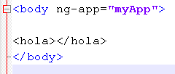
Create a new html element
In Angular Terms: Creating a new directive
How would you like to run code like this

Slide 36
You can instantiate directives by nodenames, class names, attribute names or even comment
For example:
<div class="hola"></div>
You can also restrict your directives so they can be instantiated only in certain ways.
ECMA : Element, Class, coMment, Attribute
Notes:
<div class="hola"></div>
restrict : "EAC"
Default: EA

Slide 37
There are numerous more tasks you can accomplish with Angular - quicker and with less code.
  DOM Manipulation
  Event Management
  Forms
  Validations
  SQL integration

Slide 38
Dependency injection
Two Way Data-Binding
Model View Controller

